Slide 1
XSLT Transformer
A simple way to convert XML through XSLT

Slide 2

What is it ??
About It
XSLT Transformer is a stand-alone HTML file, which is having capabilities to convert XML messages through XSLT. It also has other XML manipulating functions like XML structuring, making Linear XML, removing unwanted blank fields, removing comments, indentation changing etc.

Slide 3
Why do I use it ??
Key Features
Input XML, Output XML and XSLT, all in one page
Added feature of XML structuring
Added feature of removing unwanted XML fields
Added feature of changing XML indentation
Easy XSLT testing as everything can be seen in one page
Reduce XSLT testing time

Slide 4
What is extra in it ??
Advantages of Use
Light weight service.
No installation hassle.
Requires only browser, no other pre-requisite.
Offline use. No need of internet connectivity.
Portable to different environments and platforms.

Slide 5
How do I use it ??

Slide 6
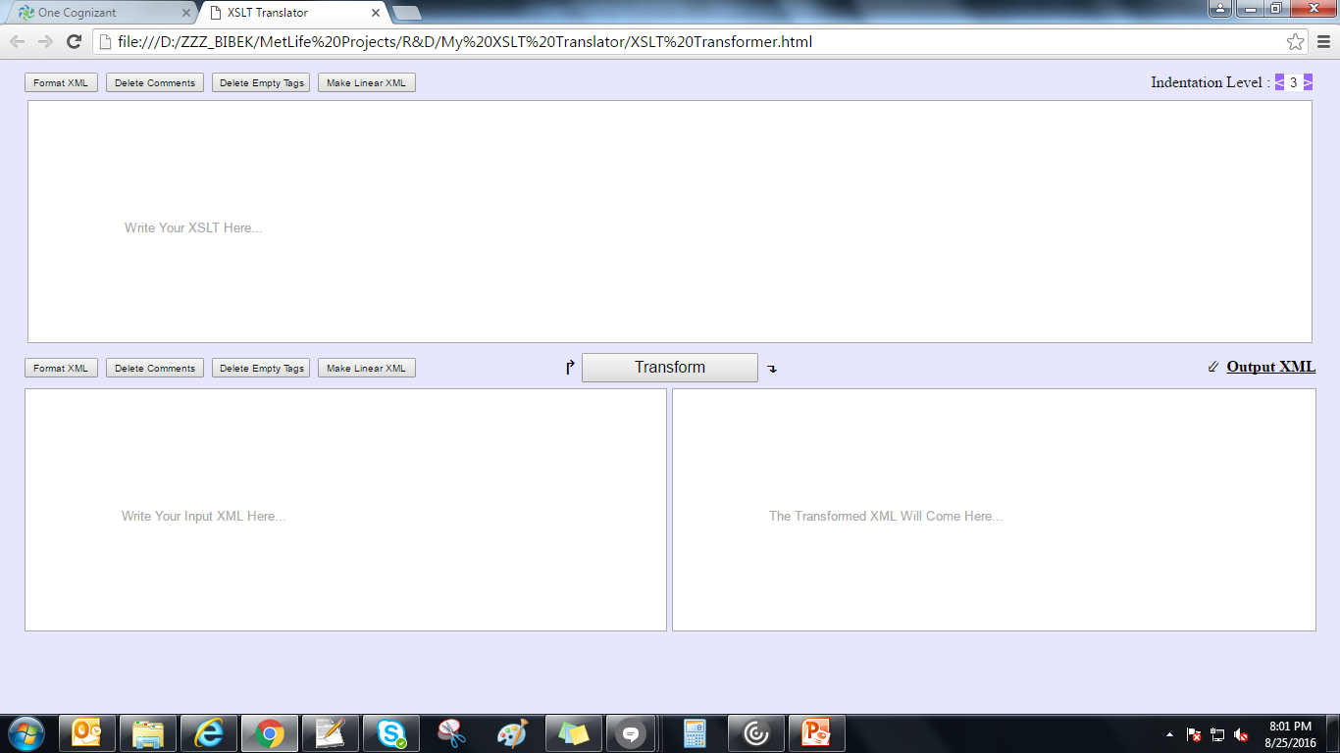
How to use it ?
Open the HTML file in web browser. Below would be the initial screen.

Slide 7
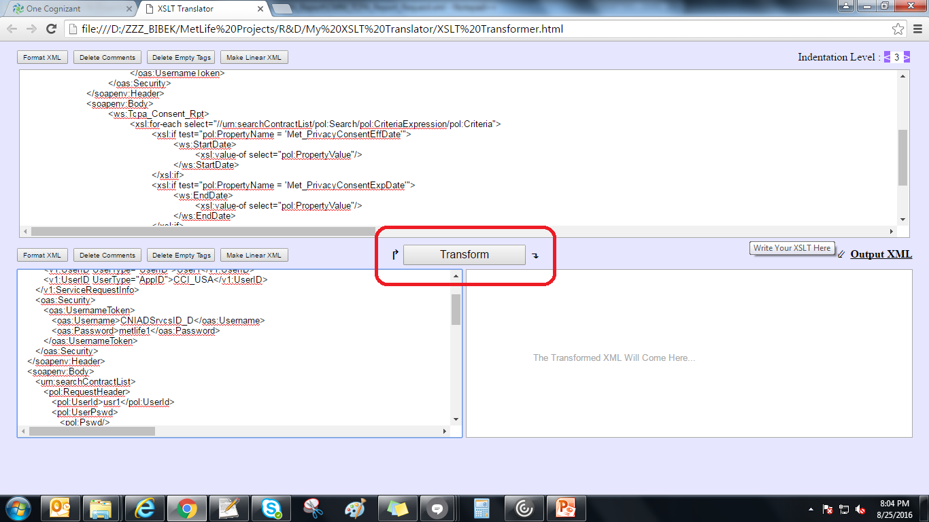
How to use it ?
Paste your XSLT and input XML and click on the ‘Transform’ button (marked below).

Slide 8
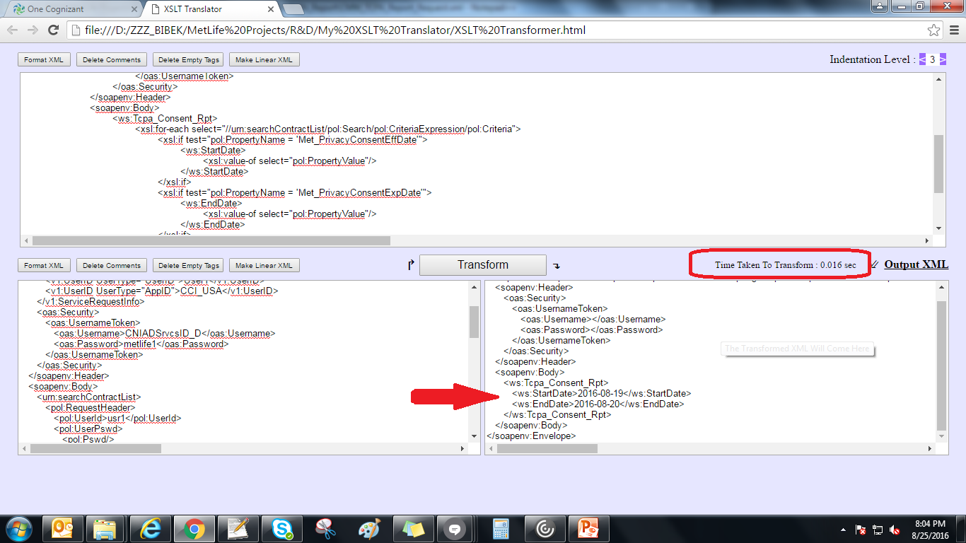
How to use it ?
The input XML would be transformed and the output XML would appear in the output section. Also the time for transformation (marked below) would be displayed there.

Slide 9
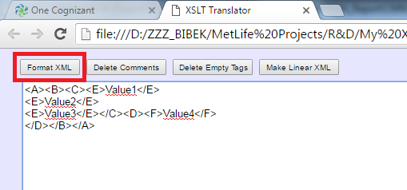
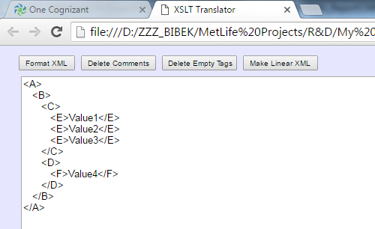
How to use it ?
Any unstructured XML can be made structured by clicking ‘Format XML’ button as below.

Slide 10
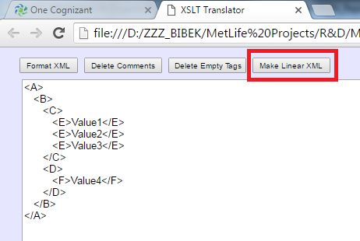
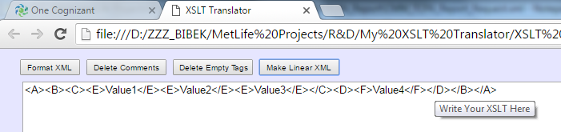
How to use it ?
Any structured or unstructured XML can be transformed into linear XML by clicking on ‘Make Linear XML’ button as below. This is effectively used when any XML is needed to be used inside another XML as CDATA section.

Slide 11
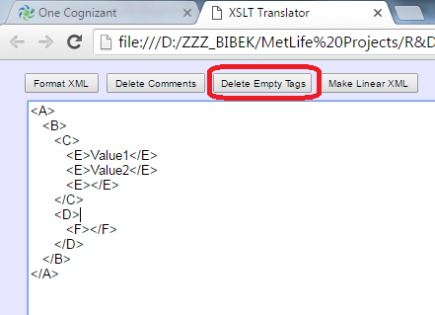
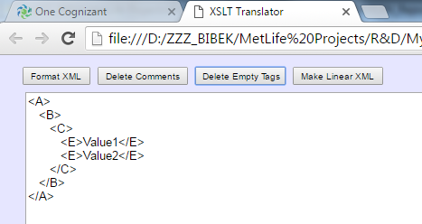
How to use it ?
You can also delete the unwanted empty fields by clicking on ‘Delete Empty Tags’ button.

Slide 12
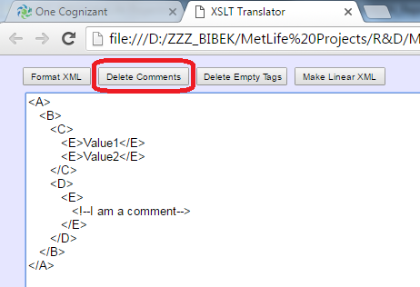
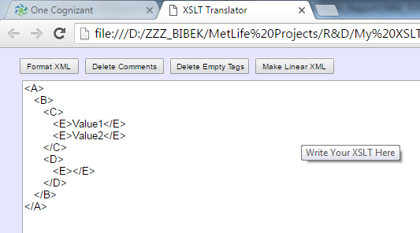
How to use it ?
All the commented tags and fields of the input XML can be removed simply by clicking on ‘Delete Comments’ button.

Slide 13
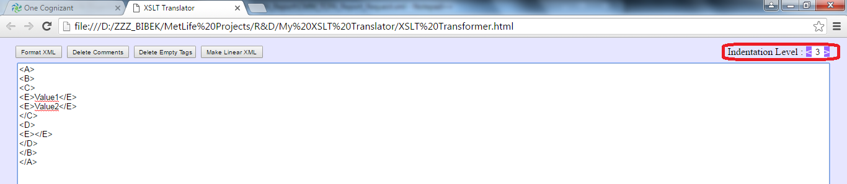
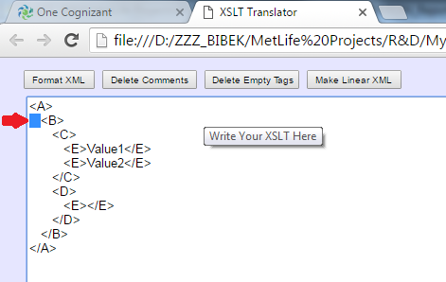
How to use it ?
The indentation of XML can also be changed by increasing or decreasing the indentation level (marked below) i.e. if indentation level is selected as 3, then 3 white spaces will come as the indentation.

Slide 14



